Slide 1
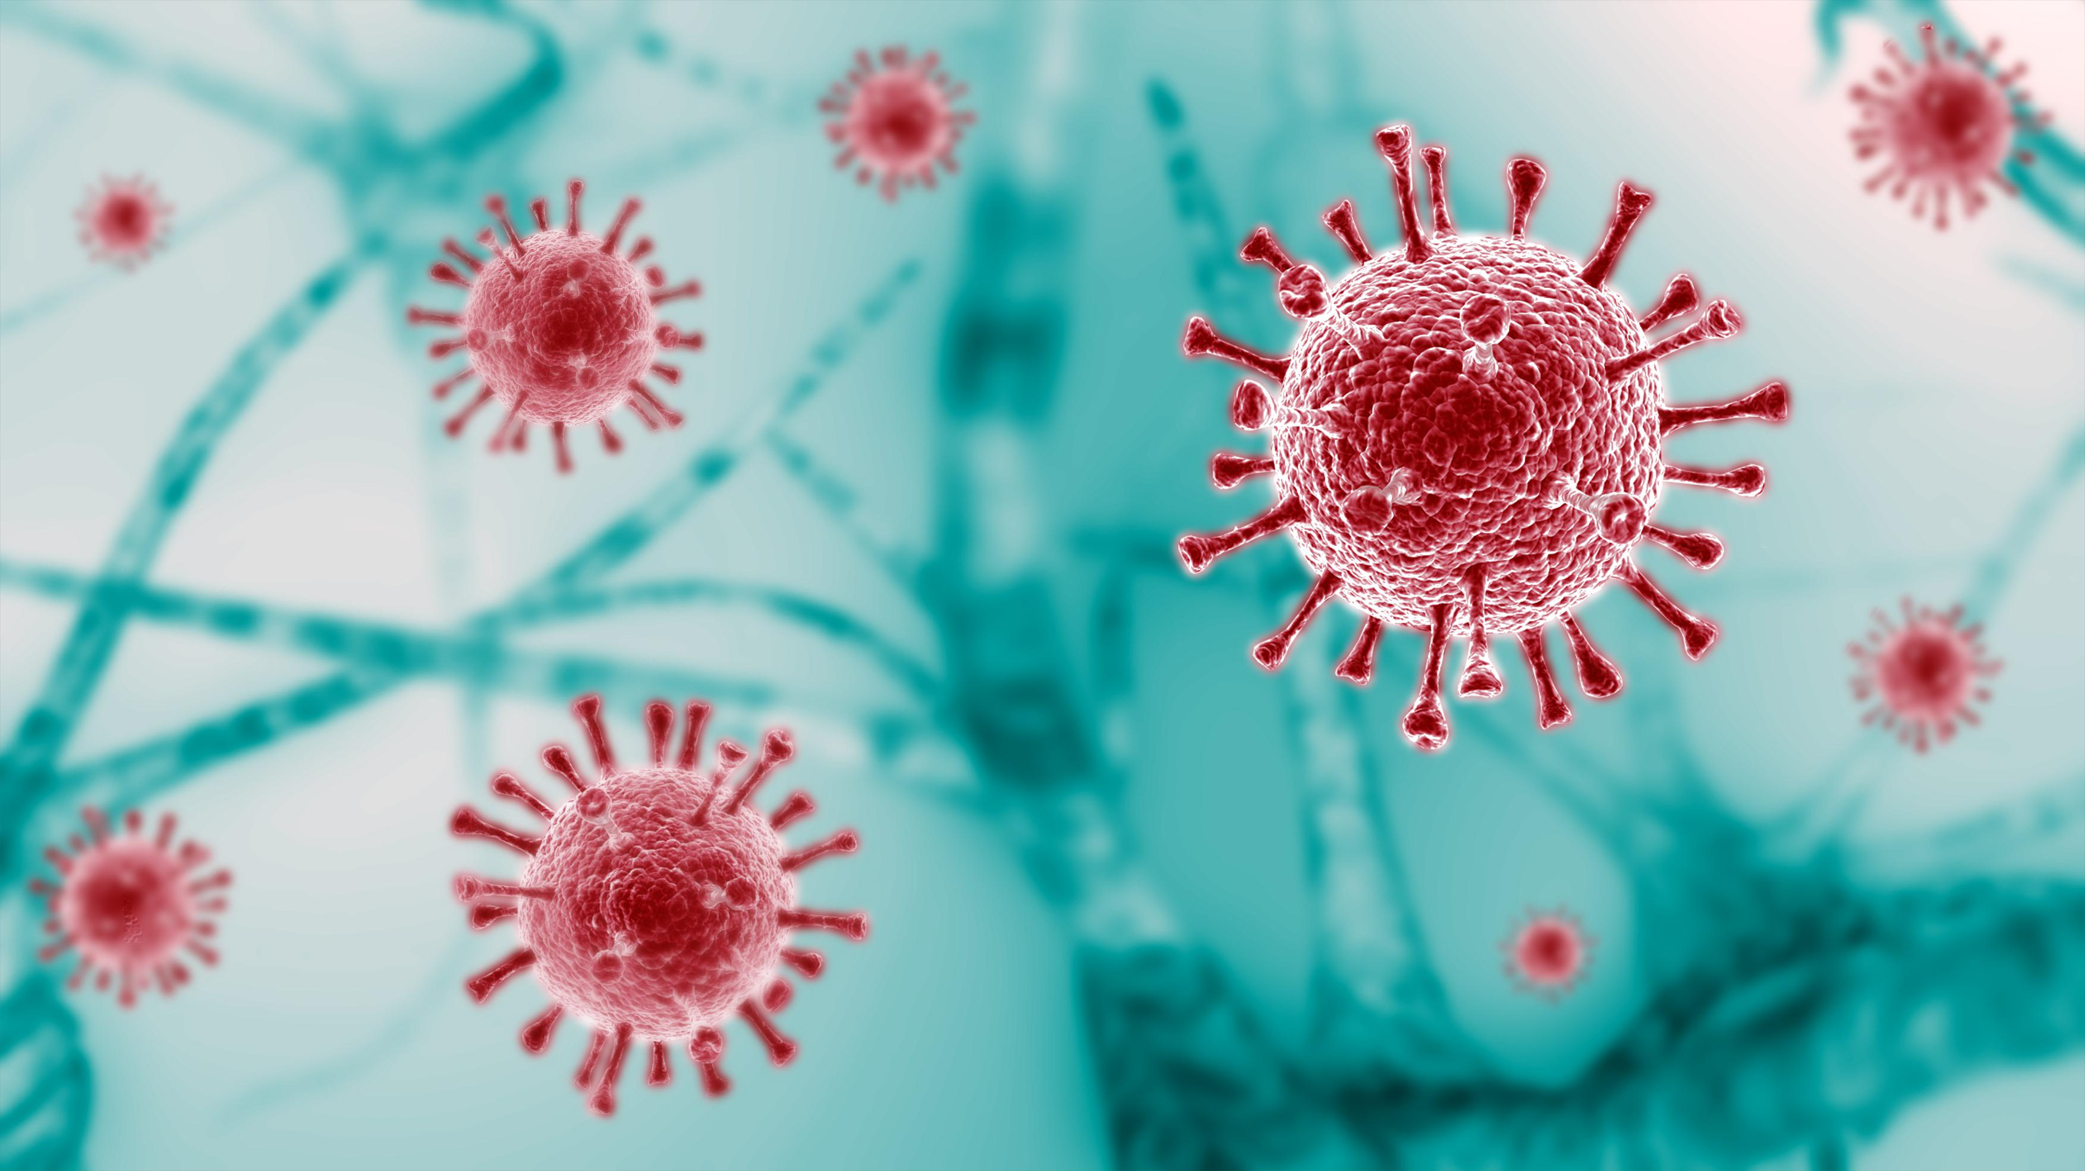
Covid-19 Prediction with Deep Learning on Neural Networks

Slide 2
Team Members:
Manideep Baddam – 700742009
Sushma Alampally – 700743513
Venkata Sivasai Kanneganti – 700756408
Sampath Kumar Chittepu - 700757946

Slide 3
Roles & Responsibilities
Manideep - Training & Testing
Sushma - Analysis of the results
Venkata Siva Sai – Collection of the Data
Sampath - Validation

Slide 4
Motivation:
Chest radiography (X-ray) is one of the trustworthy methods.
CNN can classify diseases with higher accuracy from X-ray images.
Neural Network & Deep Learning is being used in many biomedical complications.

Slide 5
Objective:
Develop the Deep Learning model using the CNN to predict possibility of Covid-19 by analyzing X-ray of a person.
To gain optimal efficiency.
Take large data sets.
To reduce the time complexity.
To increase accuracy.

Slide 6
Related Work:
The project evaluation can be tested with the Neural networks algorithm prediction results. Since the Neural networks algorithm will be used to predict the disease, the accuracy of the algorithm result will be helpful to evaluate the results. The accuracy score of the algorithm in the Covid19 disease identification helps to evaluate the dataset.
The application will be develoepd with Google Colab Python Tool as the project can be directly executed in any type computer systems with internet connection. There is no need of any specific softwares to be installed in the user system.
The Colab Tool helps to develop and run the application directly inside the cloud server where the Python libray files are installed. The Neural networks algorithm libraries are buil inside the Colab. It helps the project to use the Neural networks algorithm in the finding of Covid19 disease.

Slide 7
Problem Statement:
When worked on large data sets the accuracy of the algorithm fails while validating the X-ray images.
Understanding the differential impact of COVID-19 across age groups is a focal point. The algorithm categorizes patients into child, adolescence, adult, and senior adult groups, aiming to identify which age group is most affected by the virus.
The study aims to predict the current status of COVID-19 patients, categorizing them as recovered, hospitalized, or deceased. Additionally, it evaluates the severity of symptoms, classifying them into levels such as very high, high, moderate, low, or very low, with an accompanying accuracy calculation.

Slide 8
Proposed Solution:
To build a deep learning model that could extract covid-19 pictorial features from the X-ray image of the lungs.
Accuracy is the most significant factor.

Slide 9
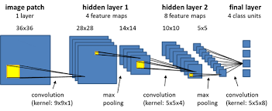
Algorithm:
CNN (Convolutional Neural Networks)
It is a deep learning algorithm which takes images as input assign importance to whereas aspects in the images and is able to differentiate one from another

Slide 10
Conclusion:
In this study we used deep learning CNN technique on Chest X-ray images of patients and classified them into two classes of patients with and without Covid-19.
This project successfully predicts the Covid-19 disease with accuracy of 95 – 98%.
This model can also be modified to determine the percentage of Covid-19 risk and predict the type of ward in which a Covid-19 patient should be admitted.

Slide 11
References:
Shreyas Setlur Arun , Ganesh Neelakanta Iyer ,“On the Analysis of COVID19 - Novel Corona Viral Disease Pandemic Spread Data Using Machine Learning Techniques”, Proceedings of the International Conference on Intelligent Computing and Control Systems (ICICCS 2020) IEEE Xplore Part Number:CFP20K74-ART; ISBN: 978-1-7281-4876-2
Mazin Abed Mohammed;Karrar Hameed Abdulkareem;Alaa S. Al-Waisy; Salama A. Mostafa;Shumoos Al-Fahdawi;Abdullah BAZ “Benchmarking Methodology for Selection of Optimal COVID-19 Diagnostic Model Based on Entropy and TOPSIS Methods”, IEEE ACCESS.2020.2995597.
A. Krizhevsky, I. Sutskever, and G. E. Hinton, “Imagenet classiﬁcation with deep convolutional neural networks,” in Advances in neural information processing systems, 2012, pp. 1097–1105.

Slide 12


